Slide 1

The Dementors
Math Game by

Slide 2
Our team
Miriam Kostadinova Georgieva
Scrum Trainer
Ivan Dyankov Staev
Developer 2 C++
Marieta Petkova Stoycheva
Developer 2 C++
Martin Valentinov Martinov
Developer 3 Code Check
Teodora Nikolaeva Kompanska
Developer 1 Front End

Slide 3
Stages of realization
First stage – planning.
Second stage - realization.
Third stage – presentation.

Slide 4
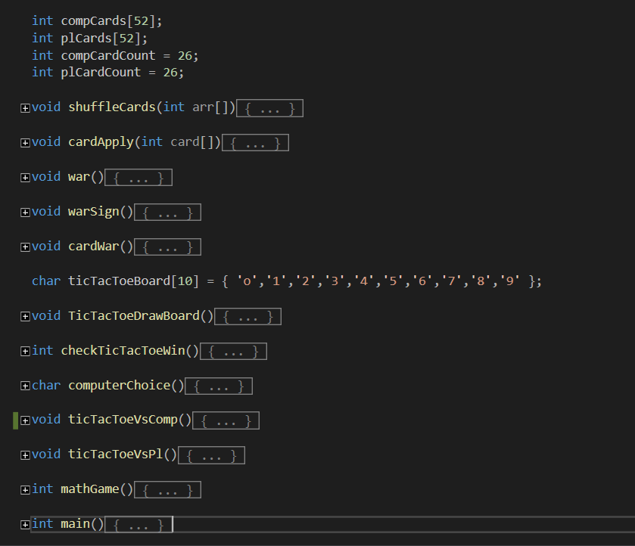
Functions we used

Slide 5






Programs we used

Slide 6
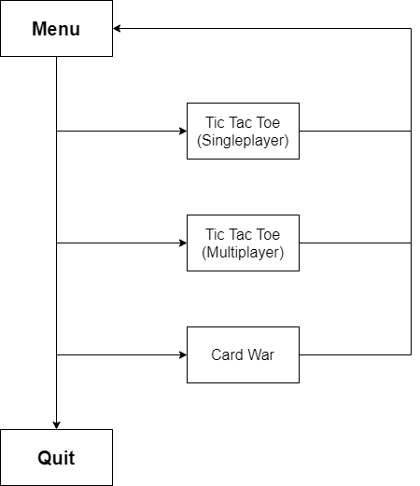
Flowchart of our program

Slide 7
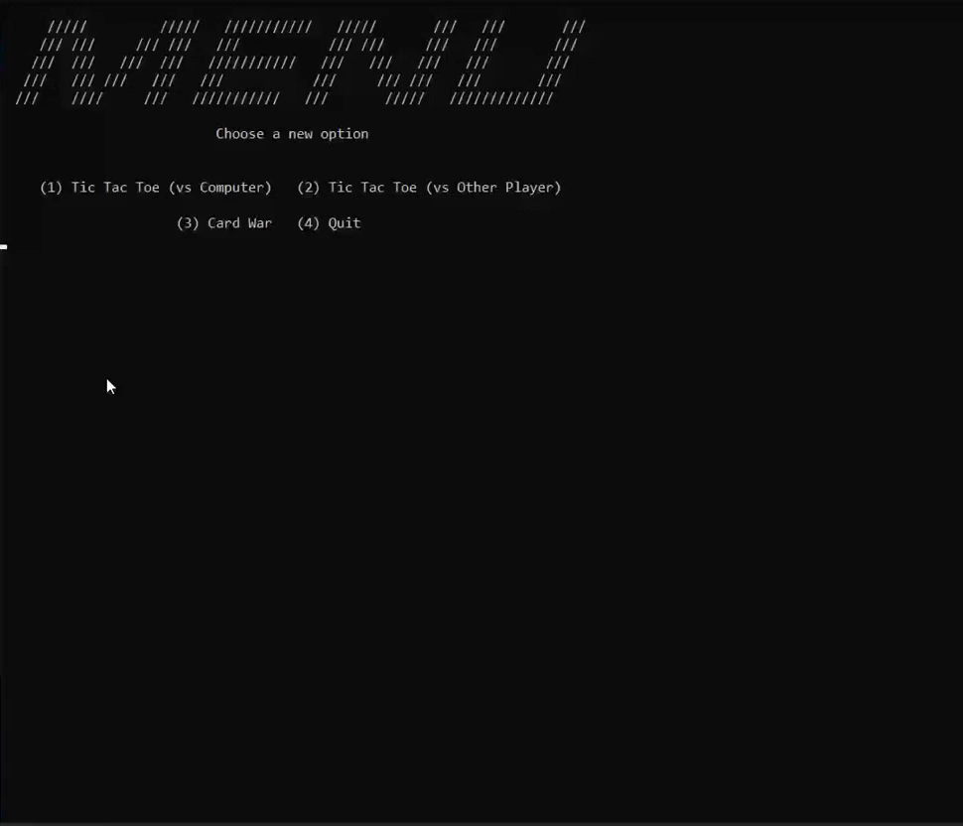
How does the program work?

Slide 8
Thank you for your attention!

